Slide 1
Segmenting and Clustering Neighborhoods in Fredericton, NB
Applied Data Science Capstone Week 5 Peer-Graded Project Report

Slide 2
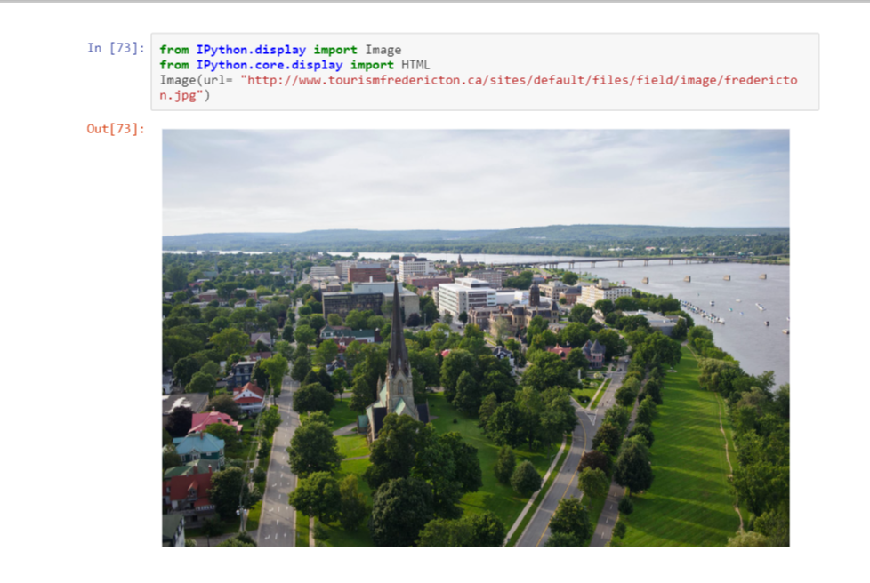

Slide 3
DATA
To understand and explore we will need the following City of Fredericton Open Data:
1. Open Data Site: http://data-fredericton.opendata.arcgis.com/
2. Fredericton Neighbourhoods: http://data- fredericton.opendata.arcgis.com/datasets/neighbourhoods--quartiers
3. Fredericton Crime by Neighbourhood: http://data-fredericton.opendata.arcgis.com/datasets/crime-by-neighbourhood-2017--crime-par-quartier-2017
4. Fredericton Census Tract Demographics: http://data-fredericton.opendata.arcgis.com/datasets/census-tract-demographics--donn%C3%A9es-d%C3%A9mographiques-du-secteur-de-recensement
5. Fredericton locations of interest: https://github.com/JasonLUrquhart/Applied-Data-Science-Capstone/blob/master/Fredericton%20Locations.xlsx
6. Foursquare Developers Access to venue data: https://foursquare.com/

Slide 4
Methodology
The methodology will include:
Loading each data set
Examine the crime frequency by neighbourhood
Study the crime types and then pivot analysis of crime type frequency by neighbourhood
Understand correlation between crimes and population density
Perform k-means statisical analysis on venues by locations of interest based on findings from crimes and neighbourhood
Determine which venues are most common statistically in the region of greatest crime count then in all other locations of interest.
Determine if an area, such as the Knowledge Park needs a coffee shop.

Slide 5
Results
The analysis enabled us to discover and describe visually and quantitatively:
Neighbourhoods in Fredericton
Crime freqency by neighbourhood
Crime type frequency and statistics. The mean crime count in the City of Fredericton is 22.
Crime type count by neighbourhood.
Theft from motor vehicles is most prevalent in the same area as the most frequent crimes. It's interesting to note this area is mostly residential and most do not have garages. It would be interesting to further examine if surveillance is a deterant for motor vehicle crimes in the downtown core compared to low surveillance in the Platt neighbourhood.

Slide 6
Discussion and Recommendations
The City of Fredericton Open Data enables us to gain an understanding of the crime volume by type by area but not specific enough to understand the distribution properties. Valuable questions such as, "are these crimes occuring more often in a specific area and at a certain time by a specific demographic of people?" cannot be answered nor explored due to what is reasonably assumed to be personal and private information with associated legal risks.
There is value to the city to explore the detailed crime data using data science to predict frequency, location, timing and conditions to best allocated resources for the benefit of its citizens and it's police force. However, human behaviour is complex requiring thick profile data by individual and the conditions surrounding the event(s). To be sufficient for reliable future prediction it would need to demonstrate validity, currency, reliability and sufficiency.
A note of caution is the possibility neighbourhoods names could change. The crime dataset did not mention which specific neighbourhood naming dataset it was using but we assumed the neighbourhood data provided aligned with the neighbourhoods used in the crime data. It may be beneficial for the City to note and timestamp neighbourhood naming in the future or simply reference with neighbourhood naming file it used for the crime dataset.

Slide 7
Conclusion
Using a combination of datasets from the City of Fredericton Open Data project and Foursquare venue data we were able to analyse, discover and describe neighbhourhoods, crime, population density and statistically describe quantitatively venues by locations of interest.
While overall, the City of Fredericton Open Data is interesting, it misses the details required for true valued quantitiatve analysis and predictive analytics which would be most valued by investors and developers to make appropriate investments and to minimize risk.
The Open Data project is a great start and empowers the need for a "Citizens Like Me" model to be developed where citizens of digital Fredericton are able to share their data as they wish for detailed analysis that enables the creation of valued services.

Slide 8
APPENDIX: Analysis

Slide 9
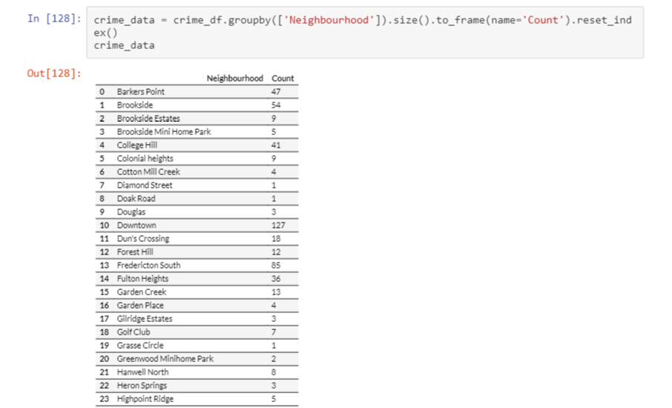
What is the crime count by neighbourhood?

Slide 10
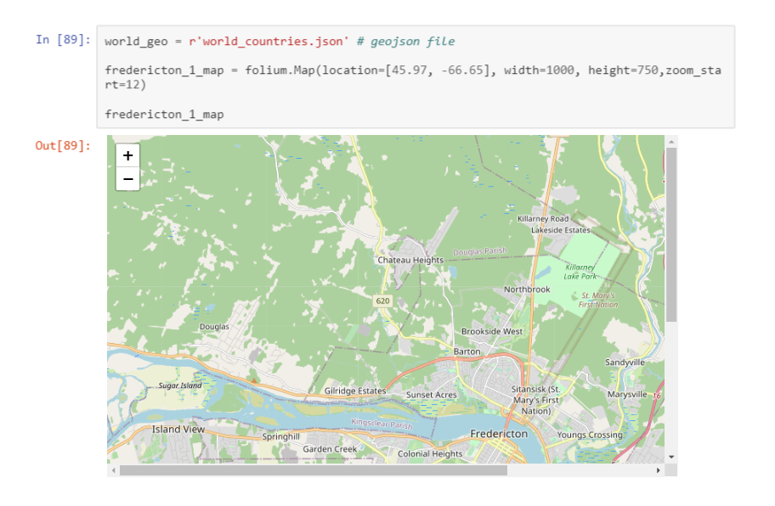

Slide 11
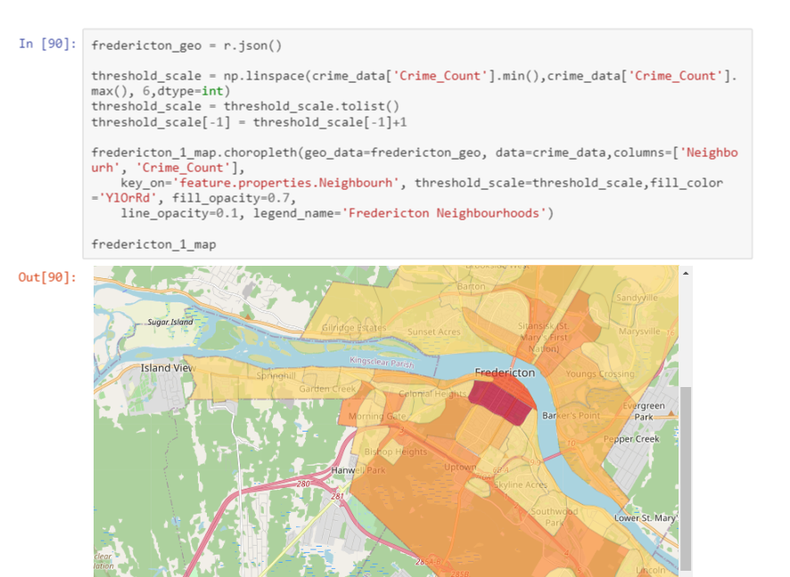

Slide 12
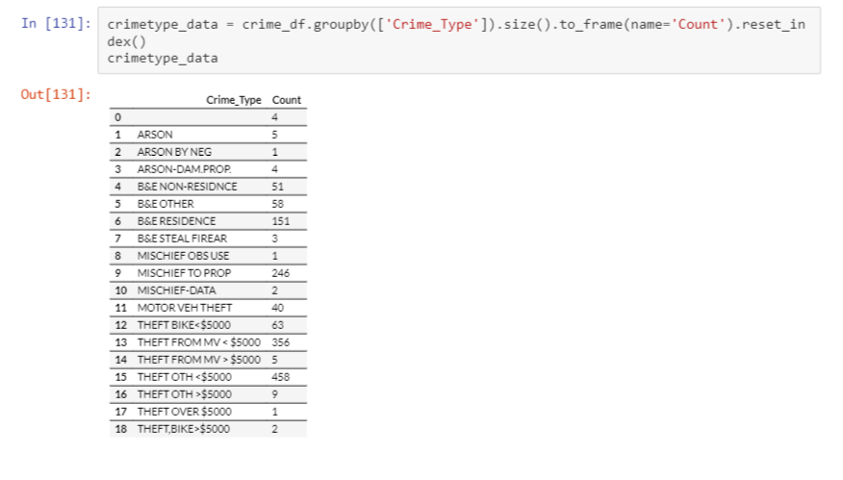
Examine Crime Types

Slide 13
Let's examine theft from vehicles

Slide 14
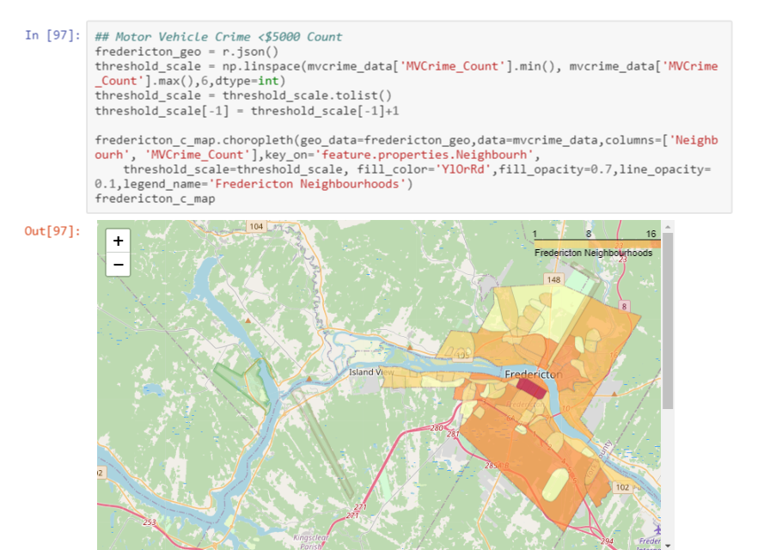

Slide 15
Is it possible the higher rate of crime in the downtown area is due to population density?

Slide 16
